Slide 1
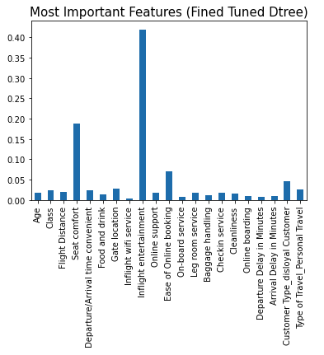
Enhancing Customer Satisfaction through Predictive Analytics
Prepared for: Invistico Airlines Senior Analyst Team
Invistico Airlines has utilized predictive analytics to bolster customer satisfaction. Employing a decision tree model, this initiative aims to pinpoint and enhance critical aspects of the customer experience based on comprehensive analysis of historical flight data.
The primary goal was to identify significant factors influencing customer satisfaction
Evaluate the model's effectiveness using accuracy, precision, recall, and F1-score.
Model Accuracy: Achieved over 94% accuracy in predicting customer satisfaction levels.
Precision and Recall: High precision with a focus on minimizing incorrect satisfaction classifications; recall emphasized the need to reduce false negatives.
Influential Factors: Identified inflight entertainment, seat comfort, and ease of online booking as top predictors of customer satisfaction.
Enhance Customer Experience: Prioritize improvements in inflight entertainment, seat comfort, and booking processes.
Refine Predictive Model: Continue refining the model by integrating additional data and exploring more advanced analytical methods to increase precision and reduce misclassifications.
Notes:
Image Credits
Android Phone Icon: Created by Devendra Karkar from the Noun Project
iPhone Icon: Created by Landan Lloyd from the Noun Project

